Slide 1
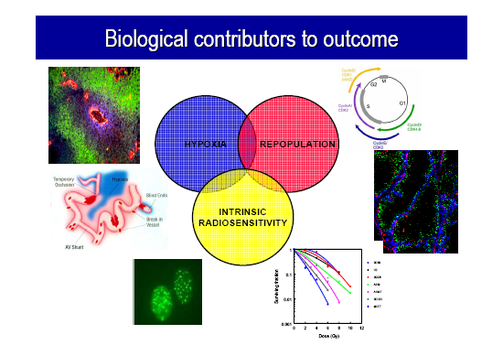

Slide 2
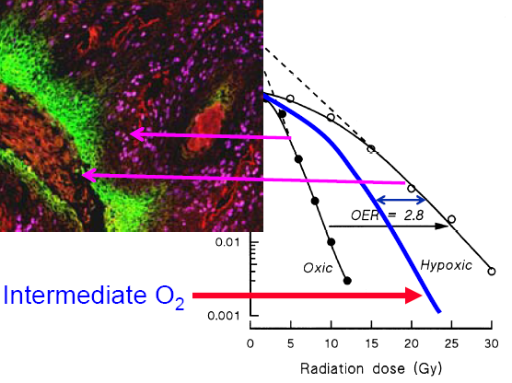

Slide 3
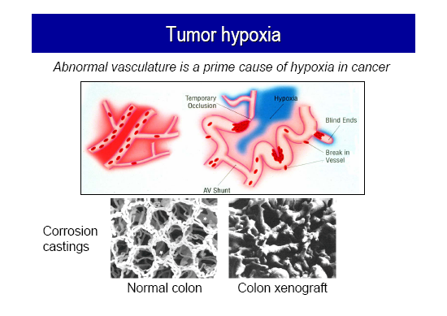

Slide 4
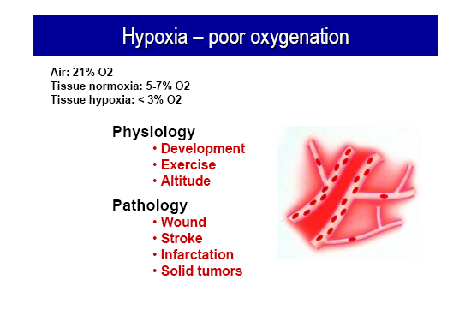

Slide 5
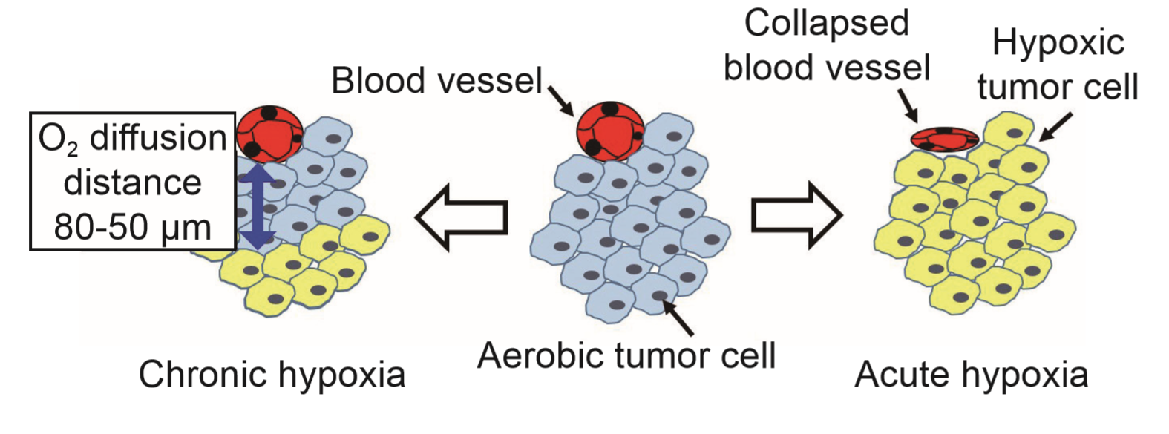

Slide 6
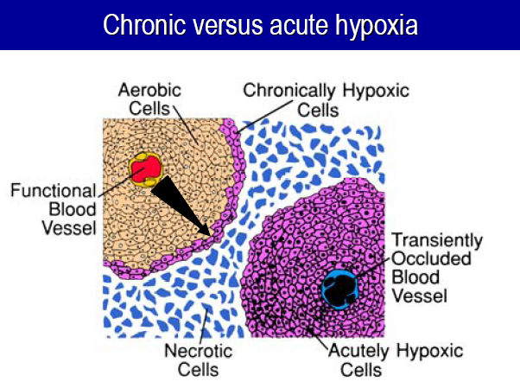

Slide 8
HYPOXIA
If molecular oxygen is present, DNA reacts with the free radicals (R·)
The DNA radical can be chemically restored to its reduced form through reaction with a sulfhydryl (SH) group.
However, the formation of RO2 ·, an organic peroxide, represents a nonrestorable form of the target material; that is, the reaction results in a change in the chemical composition of the material exposed to the radiation.
This reaction cannot take place in the absence of oxygen; since then, many of the ionized target molecules are able to repair themselves and recover the ability to function normally. In a sense, then, oxygen may be said to “fix” or make permanent the radiation lesion.

Slide 9
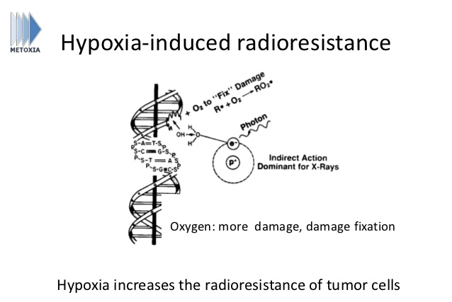

Slide 10
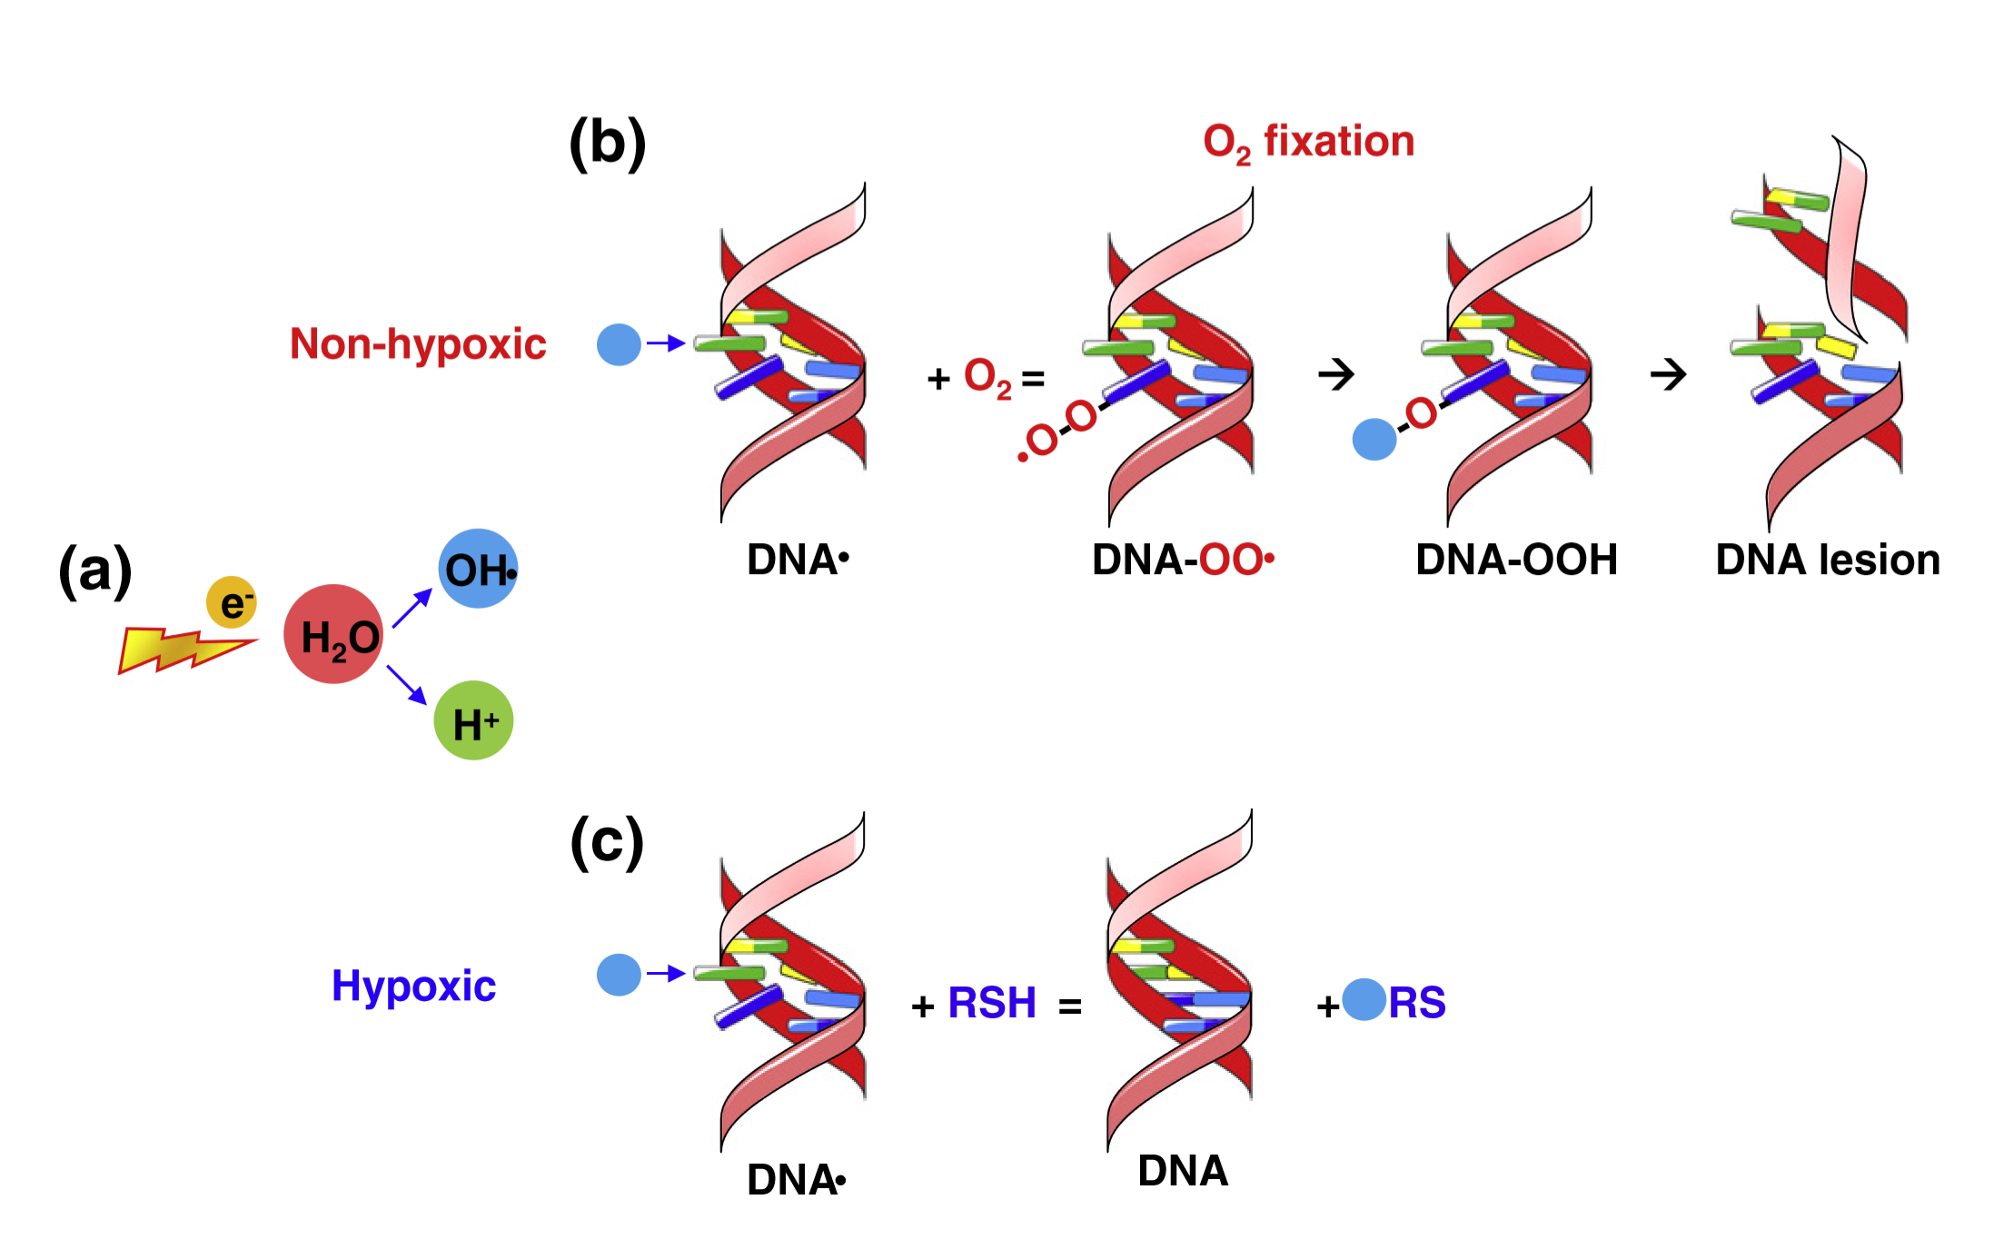

Slide 11
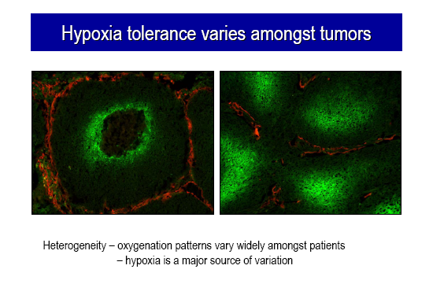

Slide 12
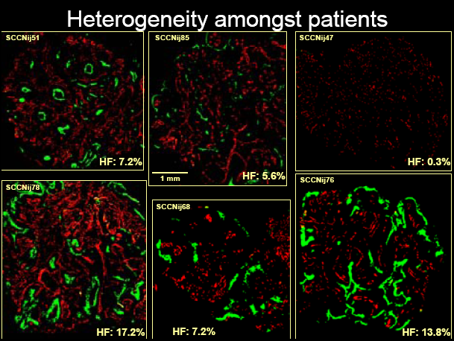

Slide 13
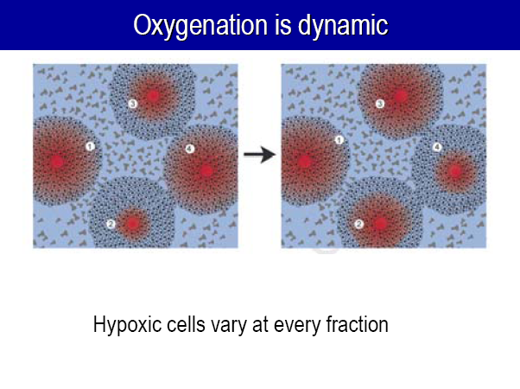

Slide 14
CHRONIC AND ACUTE HYPOXIA
Hypoxia in tumors can result from two quite different mechanisms.
Chronic hypoxia results from the limited diffusion distance of oxygen through tissue that is
respiring.
The distance to which oxygen can diffuse is largely limited by the rapid rate at which
it is metabolized by respiring tumor cells.
Many tumor cells may remain hypoxic for long periods.
In contrast to chronic hypoxia, acute hypoxia is the result of the temporary closing of a tumor blood vessel owing to the malformed vasculature of the tumor, which lacks smooth muscle and often has an incomplete endothelial lining and basement membrane.
Tumor cells are exposed to a continuum of oxygen concentrations, ranging from the highest in cells surrounding the capillaries to almost anoxic conditions in cells more distant from the capillaries.
This is significant because both chronic and acute hypoxia have been shown to drive malignant progression

Slide 15
Acute Hypoxia
Regions of acute hypoxia develop in tumors as a result of the temporary closing or blockage of a particular blood vessel.
If this blockage were permanent, the cells downstream, of course, would eventually die and be of no further consequence.
There is, however, good evidence that tumor blood vessels open and close in a random fashion, so that different regions of the tumor become hypoxic intermittently.
In fact, acute hypoxia results from transient fluctuations in blood flow because of the malformed vasculature.
At the moment when a dose of radiation is delivered, a proportion of tumor cells may be hypoxic, but if the radiation is delayed until a later time, a different group of cells may be hypoxic

Slide 16
Markers of Hypoxia
The idea of using hypoxia markers originated from the development of 2-nitroimidazoles, hypoxic
radiosensitizers that bind irreversibly to macromolecules in hypoxic cells.
These compounds are administered systemically, but are only metabolized to form adducts under hypoxic conditions.
Pimonidazole is an example of a hypoxia marker, which forms adducts in hypoxic tumor cells that can be detected by tumor biopsy and immunohistochemistry.
The advantages of hypoxia markers over oxygen electrodes include:
(1) that they provide the relative oxygen concentrations on an individual cell basis,
(2) that they make it possible to distinguish between viable and necrotic tissue,
(3) that they make it possible to distinguish between chronic and acute hypoxia.

Slide 17
Markers of Hypoxia
Radioactively labeled nitroimidazoles and other redox-sensitive compounds have been developed
to monitor tissue hypoxia noninvasively.
Although noninvasive imaging of hypoxia has a lower resolution than invasive approaches, it has
the distinct advantage of monitoring changes in oxygenation of both the primary tumor and
metastases.
Various positron emission tomography (PET) and single photon emission computed tomography (SPECT) imaging agents are available, including 18F-MISO, 18F-EF5,60Cu-ATSM, and 123I-IAZA.
The use of these agents in combination with IMRT theoretically allows the development of “physiologically targeted radiotherapy,” in which different portions of the tumor can receive different radiation doses based on differences in physiology such as oxygen tension.
This is commonly referred to as“dose painting.”

Slide 18
MECHANISM OF REOXYGENATION
In experimental animals, some tumors take several days to reoxygenate;
In others, the process appears to be complete within 1 hour or so.
In a few tumors, both fast and slow components to reoxygenation are evident.
The differences of timescale reflect the different types of hypoxia that are being reversed, chronic versus acute.
In the long term, a restructuring or a revascularization of the tumor occurs as the cells killed by the radiation are broken down and removed from the population.
As the tumor shrinks in size, surviving cells that previously were beyond the range of oxygen diffusion are closer to a blood supply and so reoxygenate.
This slow component of reoxygenation, taking place over a period of days as the tumor shrinks, involves
reoxygenation of cells that were chronically hypoxic.
By contrast, the fast component of reoxygenation, which is complete within hours, is caused by the reoxygenation of acutely hypoxic cells; that is, those cells that were hypoxic at the time of irradiation because they were in regions in which a blood vessel was temporarily closed quickly reoxygenate when that vessel is reopened.

Slide 19
HYPOXIA AND CHEMORESISTANCE
Hypoxia can also decrease the efficacy of some chemotherapeutic agents owing to
fluctuating blood flow,
drug diffusion distance,
decreased proliferation.
In addition, some chemotherapeutic agents that induce DNA damage ie. doxorubicin and bleomycin), are less efficient at killing hypoxic tumor cells in part because of decreased free-radical generation.
Experimental animal studies have shown that 5-FU, methotrexate, and cisplatin are less effective at killing hypoxic cells than they are at killing normoxic tumor cells.
Furthermore, hypoxic tumor regions are frequently associated with a low pH that can also diminish the activity of some chemotherapy agents.

Slide 20
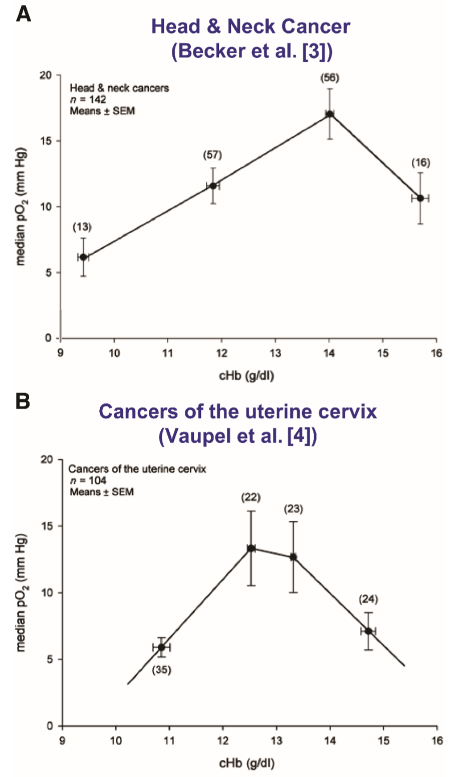
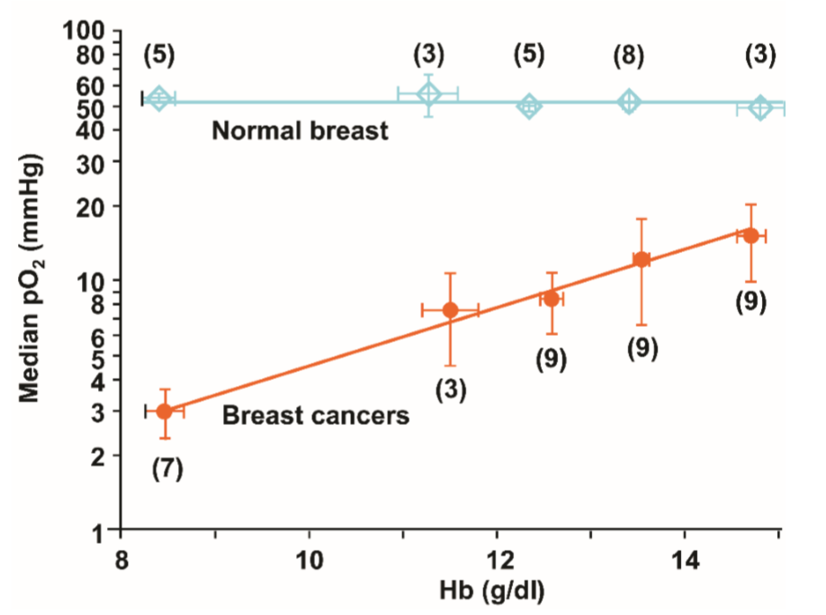
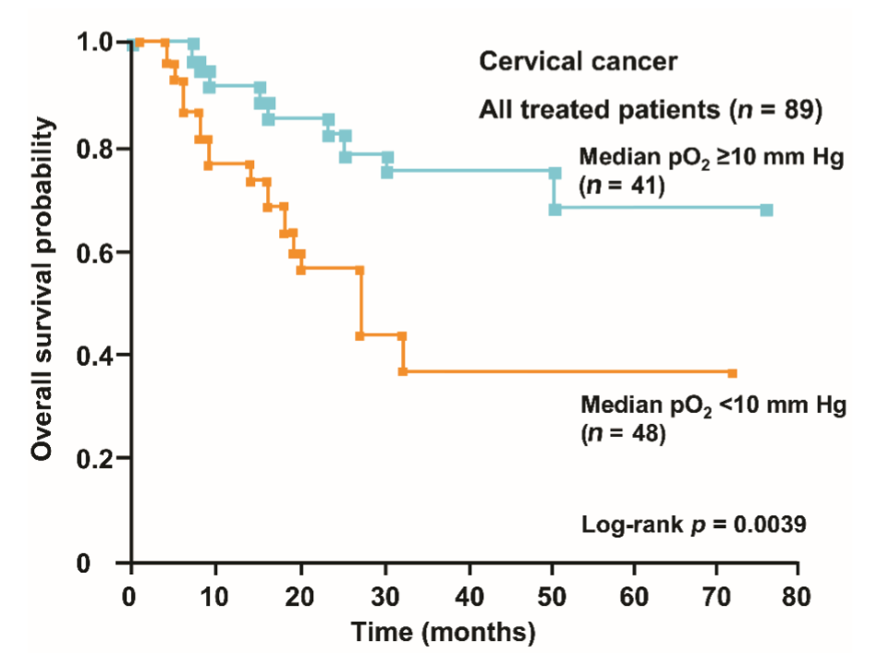

Slide 21
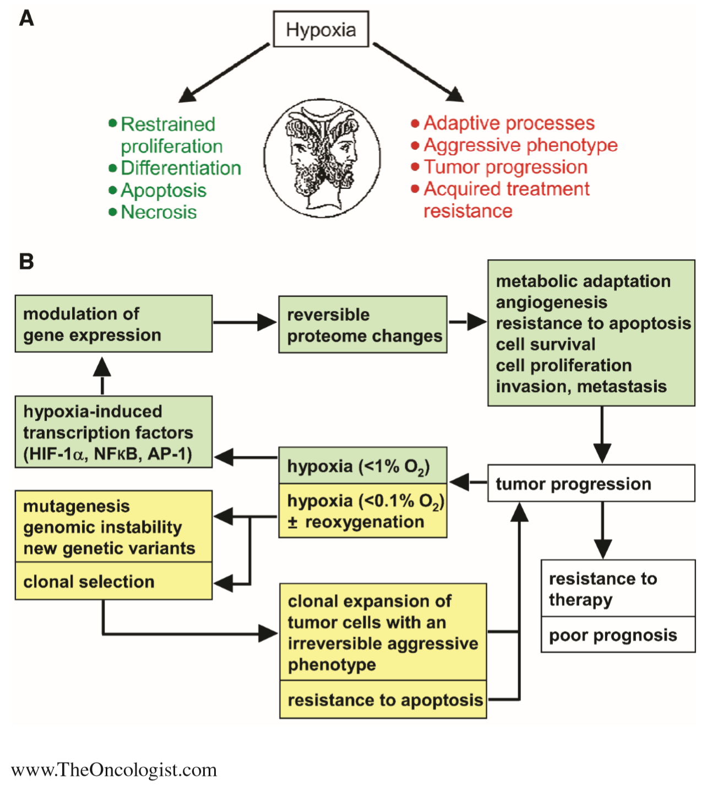

Slide 22
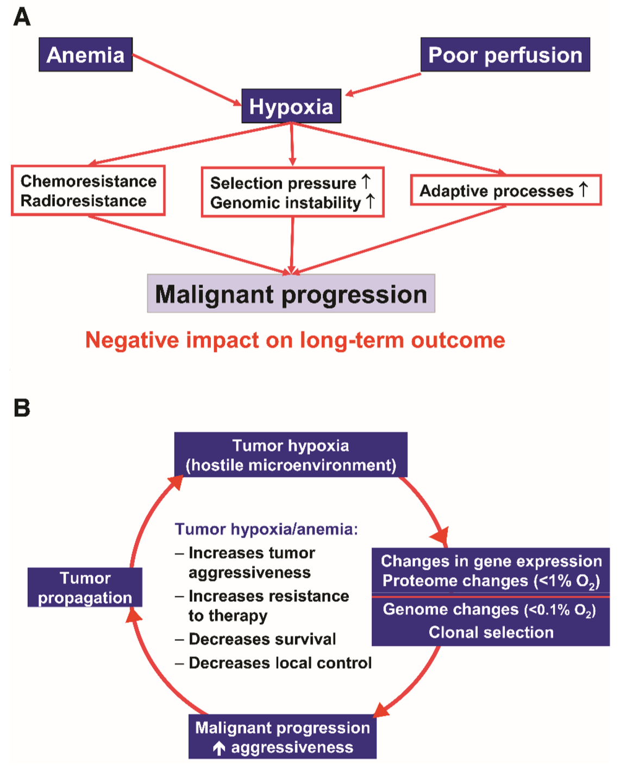

Slide 23
The Biology and Exploitation of Tumor Hypoxia
Oxygen homeostasis is deregulated in several pathologic settings.
Hypoxia, or low oxygen conditions, exists in virtually all solid tumors.
As tumor cells rapidly expand, their growth outpaces the ability of the existing vasculature to supply both nutrients and oxygen, resulting in tumor hypoxia.
Cells experiencing hypoxia can cope with the low oxygen tension by either increasing delivery of oxygen or adapting to the low oxygen level.

Slide 24
The Biology and Exploitation of Tumor Hypoxia
Hypoxia-inducible factors (HIFs) are transcription factors that facilitate both oxygen delivery and adaptation to oxygen deprivation by regulating the expression of genes that are involved in many cellular processes including
- glucose uptake and metabolism,
- angiogenesis,
- erythropoiesis,
- cell proliferation,
- apoptosis.
HIF-1,-2, and -3 regulate transcriptional programs in response to low oxygen levels

Slide 25
Important Roles of Hypoxia-Inducible Factor in Tumors
Tumor Angiogenesis
The formation of new blood vessels is critical for tumor expansion because the supply of oxygen and nutrients becomes limited in tumor cells that are located more than 100 um away from a blood vessel.
Unlike normal tissues where there is a balance between proangiogenic and antiangiogenic factors, tumors tip the balance toward proangiogenic factors.
Of all the proangiogenic factors induced by HIF, vascular endothelial growth factor-A (VEGF-A) appears to be the most critical because it has potent proangiogenic properties and is expressed in a large number of human tumors
(VEGF are important signaling proteins involved in both vasculogenesis (the de novo formation of the embryonic circulatory system) and angiogenesis (the growth of blood vessels from pre-existing vasculature)

Slide 26
Important Roles of Hypoxia-Inducible Factor in Tumors
Tumor Metabolism
Almost 100 years ago, cancer cells were found to shift glucose metabolism from an oxidative to glycolytic pathway.
Energy consumption from metabolic activities in normal cells relies primarily on mitochondrial oxidative phosphorylation, which is efficient and generates more adenosine triphosphate (ATP) than glycolysis. However, one of the metabolic features of cancer cells is to avidly take up glucose for aerobic glycolysis.
This inefficient pathway for energy production in cancer cells was first described by German scientist Otto Warburg in the 1920s, and is also known as the Warburg effect
This shift is characterized by decreased mitochondrial respiration and increased lactate production even with oxygen.
Numerous studies have established that HIF-1 regulates the expression of genes involved in glycolytic metabolism including glucose transporters, glycolytic enzymes, lactate production, pyruvate metabolism.

Slide 27
Important Roles of Hypoxia-Inducible Factor in Tumors
Tumor Metastasis
Metastasis is the cause of most human cancer deaths.
It occurs in a series of distinct steps that include tumor cell invasion and proliferation.
HIF activation correlates with metastasis in multiple tumors and promotes metastasis through the transcriptional regulation of key factors that govern
- cell adhesion,
- extracellular matrix formation,
- cell migration.

Slide 28
Hypoxia-Inducible Factor and Radiotherapy
HIF-1 plays an important role in determining tumor response to radiotherapy and tumor regrowth.
Radiation results in a reoxygenation-dependent increase in HIF-1 activity by 2 distinct mechanisms:
Tumor reoxygenation results in both HIF-1 stabilization and enhanced translation of HIF targets through the release of reactive oxygen species.
The effects of HIF on tumor radiosensitivity are twofold:
On one hand, HIF-1 stabilization promotes tumor vasculature radioresistance through the release of proangiogenic cytokines such as VEGF.
Paradoxically, HIF-1 can also induce tumor radiosensitivity through the induction of apoptosis.
Overall, HIF-1 stabilization promotes radioresistance because HIF-1–deficient tumors are more sensitive to radiation compared to wildtype tumors.

Slide 29
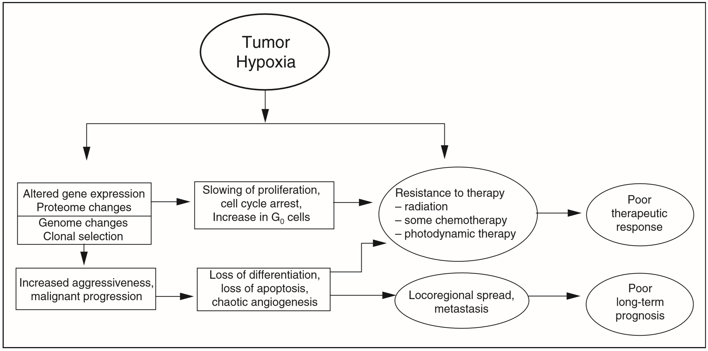

Slide 30
RADIOSENSITIZING HYPOXIC CELLS
Hyperbaric Oxygen
Following the identification of hypoxia as a possible source of tumor resistance, a major effort was made to solve the problem by the use of hyperbaric oxygen.
Patients were sealed in chambers filled with pure oxygen raised to a pressure of three atmospheres
Hyperbaric oxygen fell into disuse, partly because it is cumbersome and difficult in practice, and partly because of the promise of drugs that would achieve the same result by simpler means.

Slide 31
Hyperbaric Oxygen
The notion of improving tumor oxygenation by breathing 100% oxygen rather than air has been revived in recent years by experiments involving carbogen.
If pure oxygen is breathed, it tends to lead to vasoconstriction, a closing down of some blood vessels, which, of course, defeats the object of the exercise.
This is avoided if 5% carbon dioxide is added to the oxygen, a mixture called carbogen.
Breathing carbogen at atmospheric pressure, then, is a relatively simple attempt to overcome chronic hypoxia, that is, diffusion-limited hypoxia.

Slide 32
Improving the Oxygen Supply to Tumors
Hypoxic Cell Radiosensitizers
Compounds that mimic oxygen in their ability to sensitize biologic materials to the effects of x-rays.
Insteadof trying to “force” oxygen into tissues by the use of high-pressure tanks, the emphasis shifted to oxygen substitutes that diffuse into poorly vascularized areas of tumors and achieve the desired effect by chemical means.
The vital difference between these drugs and oxygen, on which their success depends, is that the sensitizers are not rapidly metabolized by the cells in the tumor through which they diffuse.
Because of this, they can penetrate further than oxygen and reach all of the hypoxic cells in the tumor, including those most remote from a blood supply.

Slide 33
Nicotinamide and Carbogen Breathing
A combination of nicotinamide to overcome acute hypoxia and carbogen breathing to overcome chronic hypoxia is the basis of the accelerated radiotherapy, carbogen, and nicotinamide
ARCON trials
Accelerated, to overcome proliferation
Hyperfractionated, to spare late-responding normal
tissues
Carbogen breathing, to overcome chronic hypoxia
Nicotinamide, to overcome acute hypoxia

Slide 34
Hypoxia-inducible factors (HIFs)
Transcription factors that facilitate oxygen delivery and adaptation to oxygen deprivation by regulating the expression of genes that are
involved in many cellular processes:
glucose uptake and metabolism,
angiogenesis,
erythropoiesis,
cell proliferation
- apoptosis.

Slide 35
Hypoxia-inducible factors (HIFs)
HIF-1 has been designated the global regulator of hypoxia-inducible gene expression because it is ubiquitously expressed and induces the expression
of most hypoxia inducible genes

Slide 36
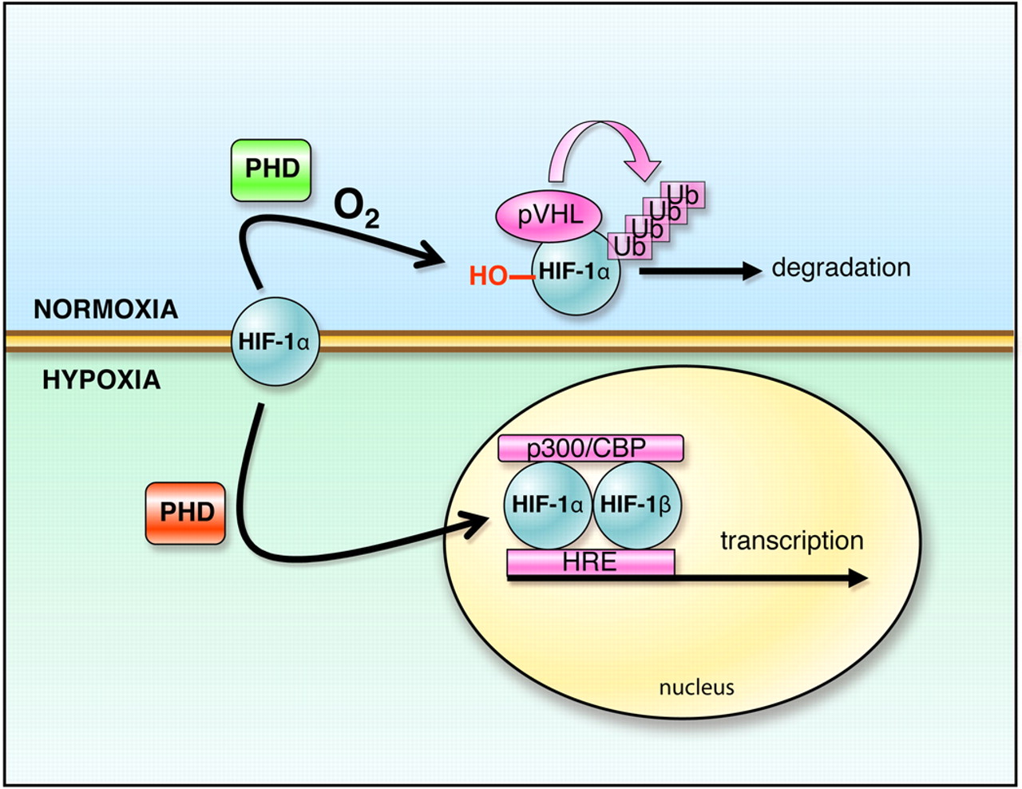
Hypoxia-inducible factors (HIFs)

Slide 37
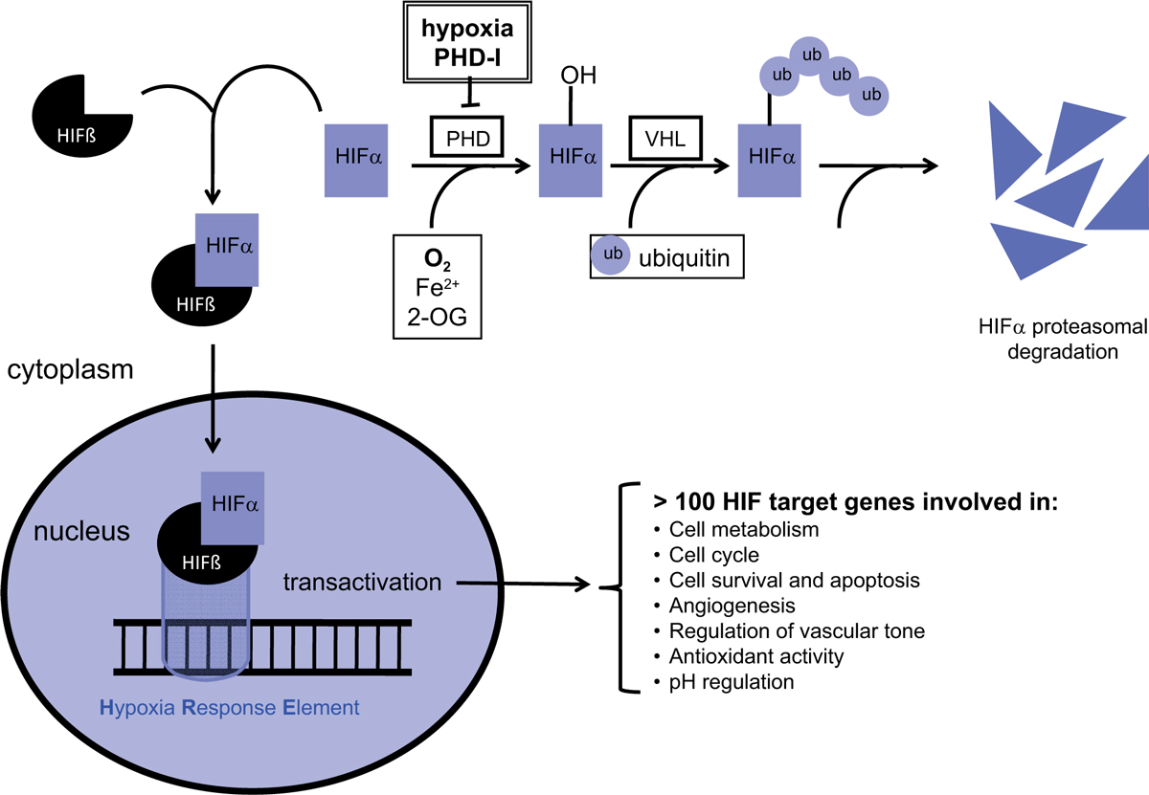
Hypoxia-inducible factors (HIFs)

Slide 38
Important Roles of Hypoxia-Inducible Factor in Tumors
The ability of tumor cells to adapt and survive
their growth inhibitory microenvironment is accomplished in part by HIF activation.
HIFs have been found to promote key steps in tumor progression,
angiogenesis,
metabolism,
metastasis.

Slide 39
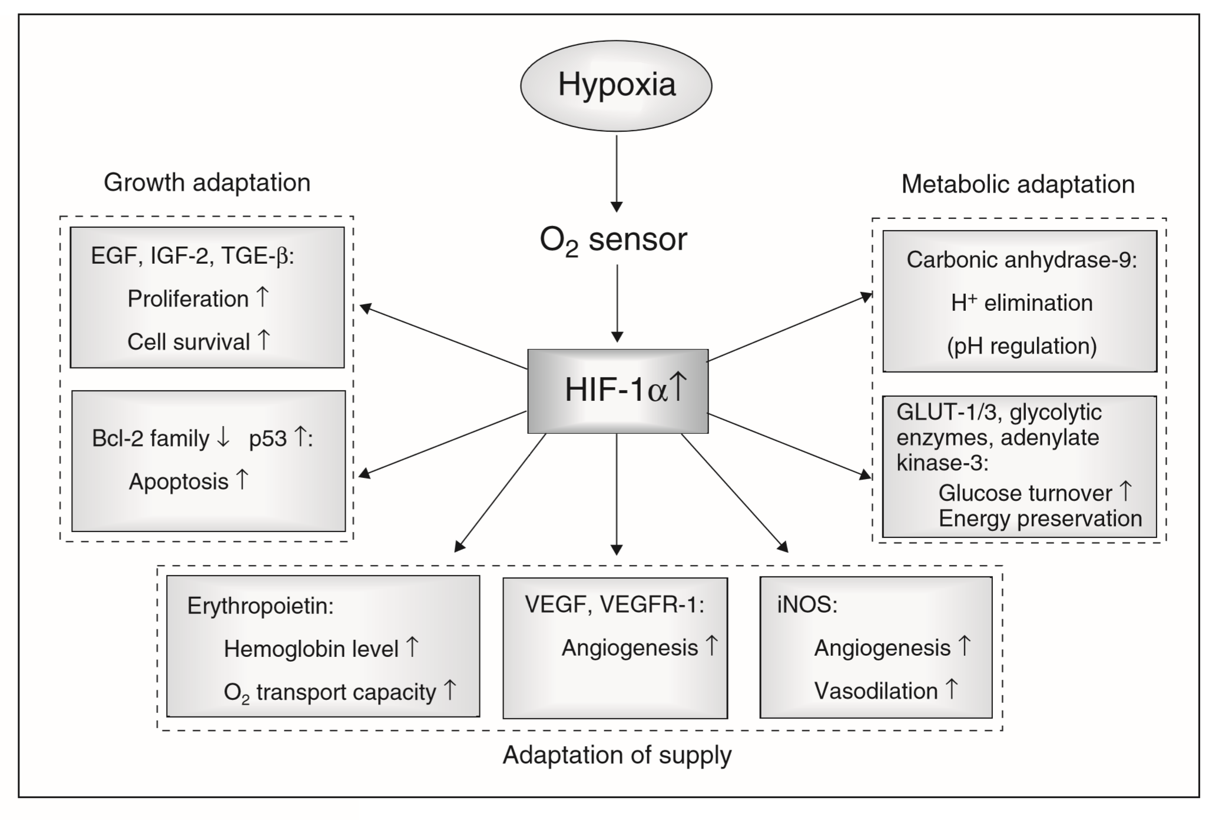

Slide 40
Tumor Angiogenesis
Unlike normal tissues where there is a balance
between proangiogenic and antiangiogenic factors,
tumors tip the balance toward proangiogenic factors.
Of all the proangiogenic factors induced by HIF, vascular endothelial growth factor-A (VEGF-A) appears to be the most critical:
- it has potent proangiogenic properties
- It is expressed in a large number of human tumors.

Slide 41
Tumor Metabolism
Cancer cells shift glucose metabolism from an oxidative
to glycolytic pathway - Warburg effect. It is characterized by decreased mitochondrial respiration and increased lactate production even with oxygen.
Numerous studies have established that HIF-1
regulates the expression of genes involved in glycolytic
metabolism including glucose transporters,
glycolytic enzymes, lactate production.

Slide 42
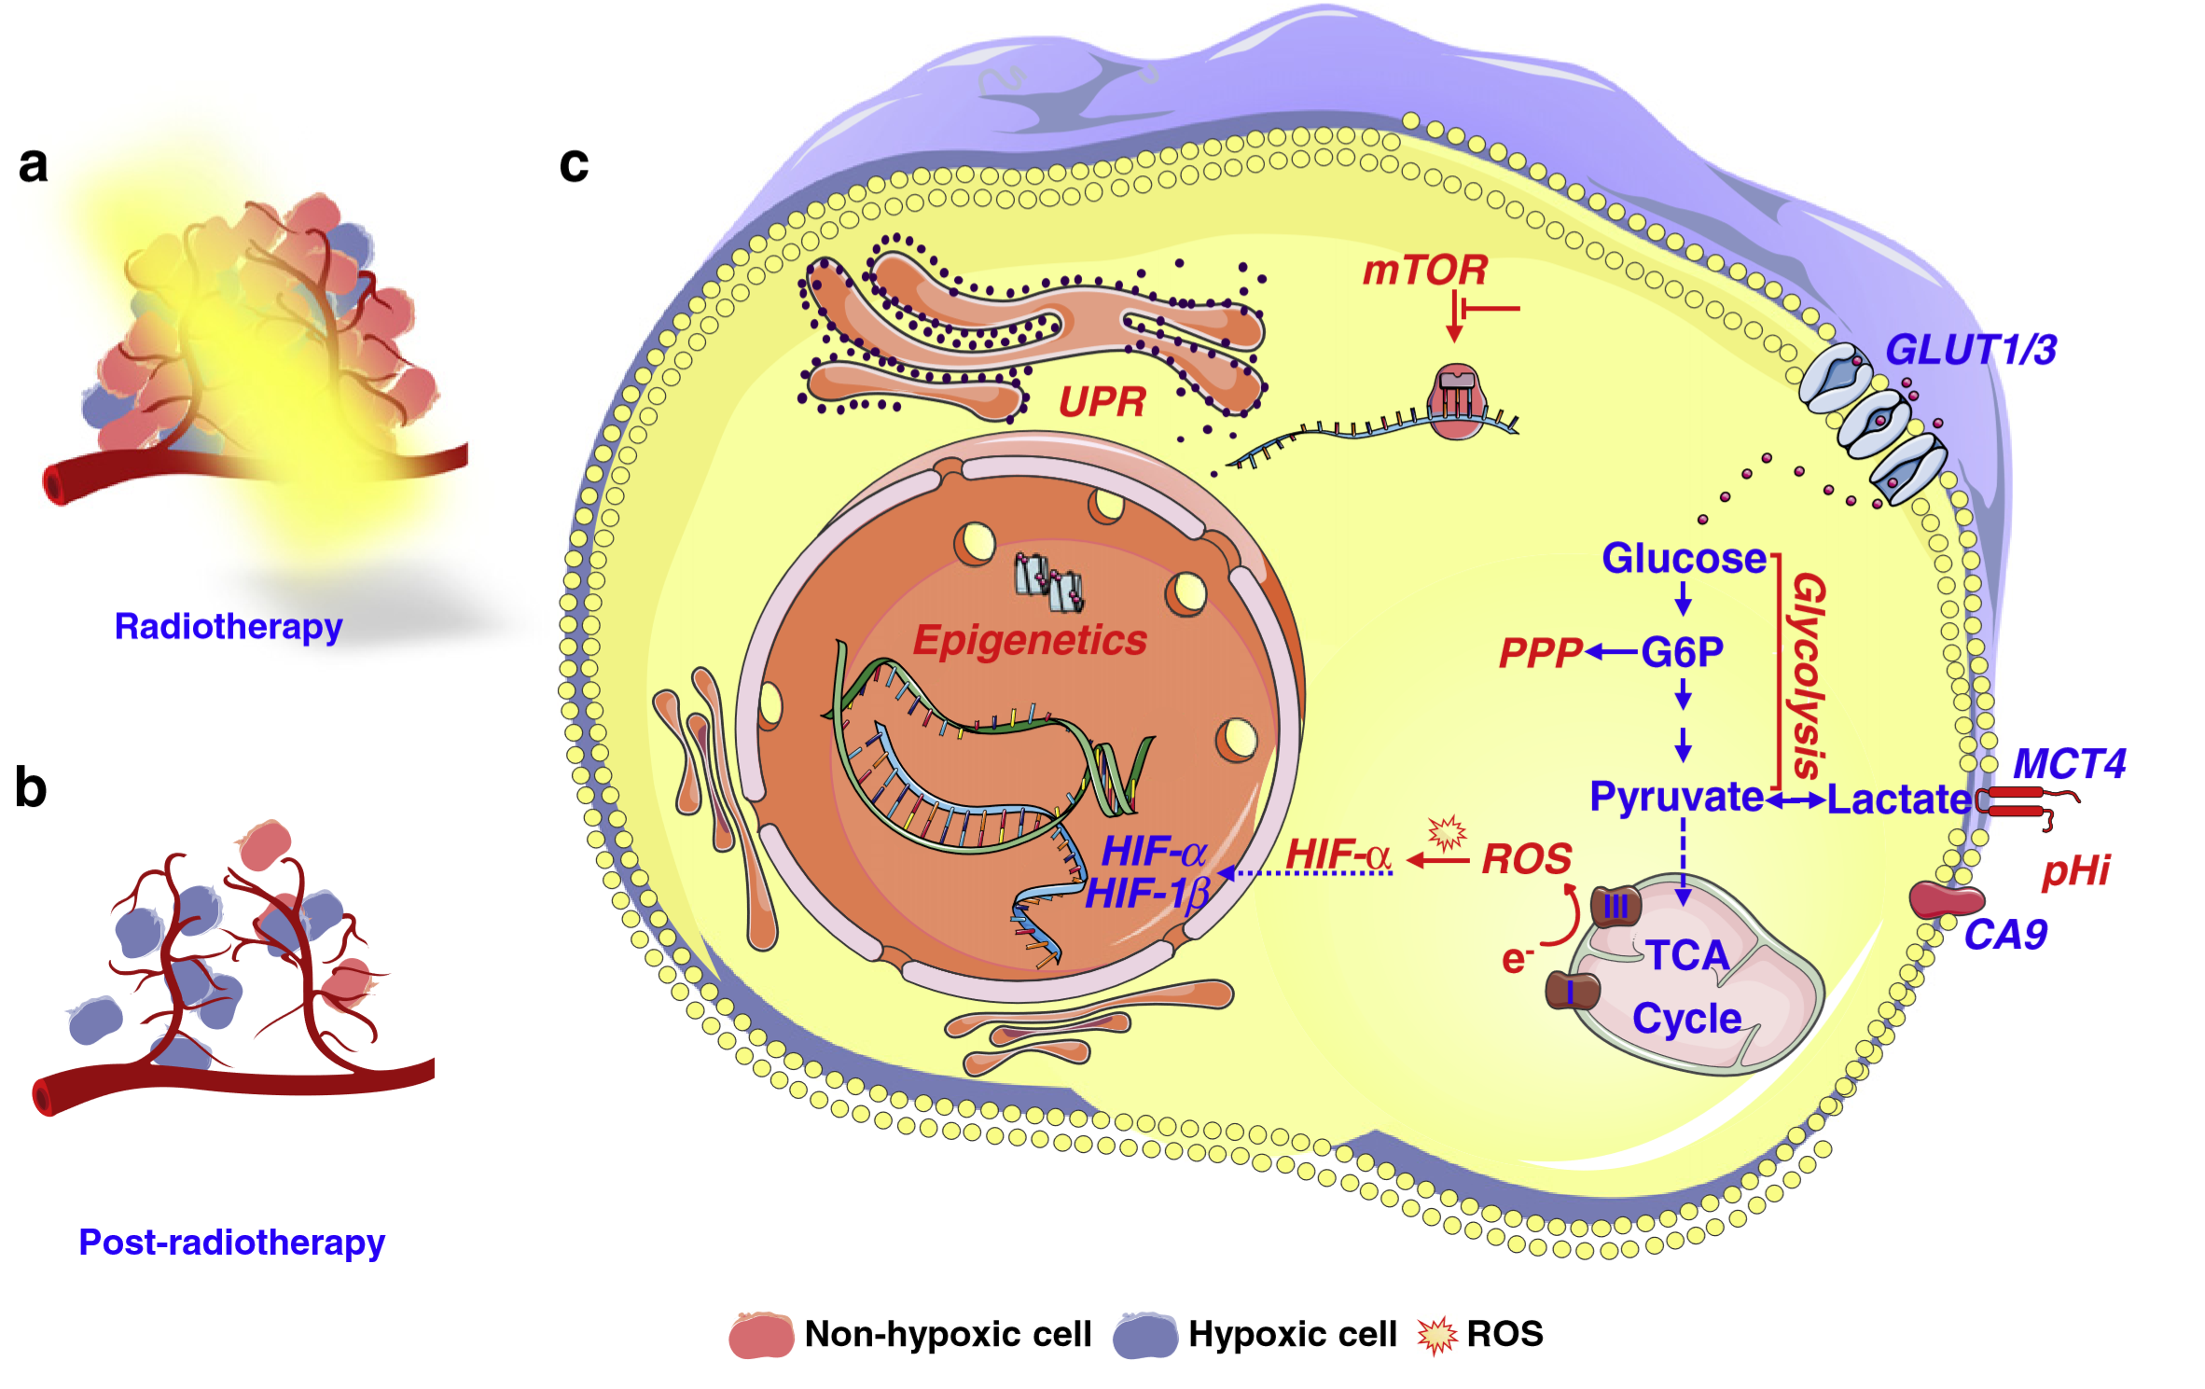

Slide 43
Tumor Metastasis
Metastasis occurs in a series of distinct steps:
include tumor cell invasion, intravasation, extravasation and proliferation.
HIF activation correlates with metastasis in multiple tumors and promotes metastasis through the regulation of key factors in:
cell adhesion,
extracellular matrix formation
cell migration

Slide 44
Hypoxia-Inducible Factor and Radiotherapy
HIF-1 plays an important role in determining tumor response to radiotherapy and tumor regrowth.
Radiation results in a reoxygenation-dependent increase in HIF-1 activity by two distinct mechanisms
Tumor reoxygenation results in both HIF-1 stabilization and enhanced translation of HIF targets through the release of reactive oxygen species

Slide 45
Hypoxia-Inducible Factor and Radiotherapy
Effects of HIF on tumor radiosensitivity:
HIF-1 stabilization promotes:
Tumor vasculature radioresistance through the release of proangiogenic cytokines such as VEGF.
Paradoxically, HIF-1 can also induce tumor radiosensitivity through the induction of apoptosis.
Overall, HIF-1 stabilization promotes radioresistance because HIF-1–deficient tumors are more sensitive to radiation compared to wildtype tumors.

Slide 46
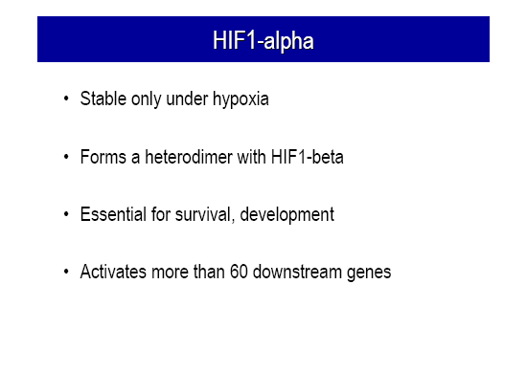

Slide 47
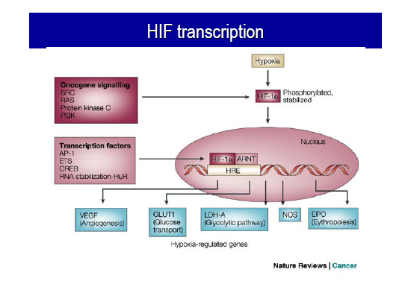

Slide 48
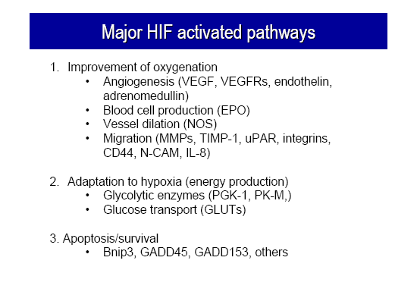

Slide 49
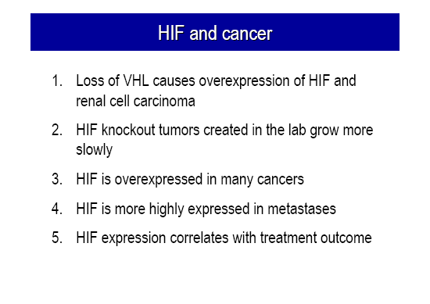

Slide 50
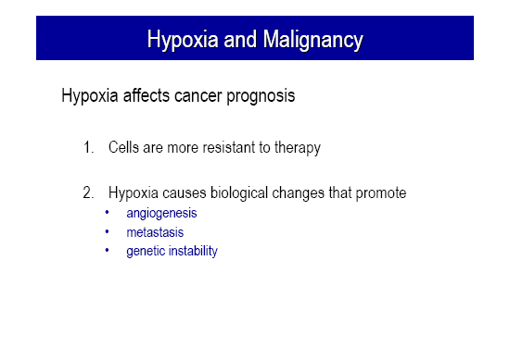

Slide 51
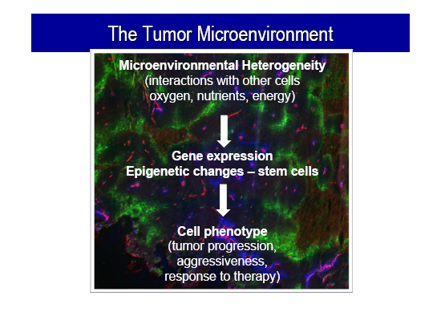

Slide 52
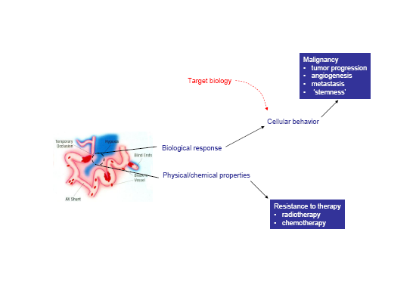

Slide 53
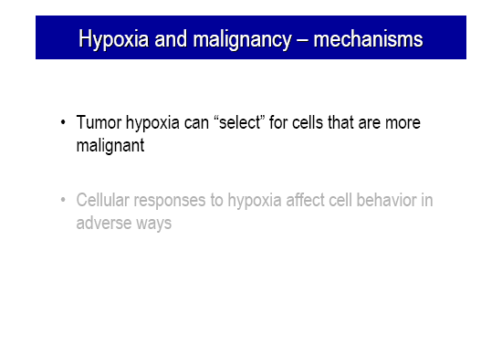

Slide 54
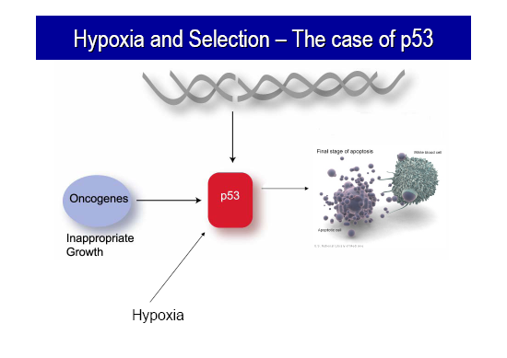

Slide 55
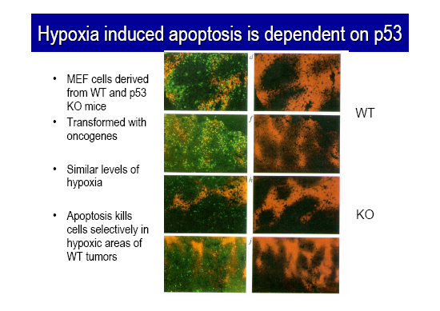

Slide 56
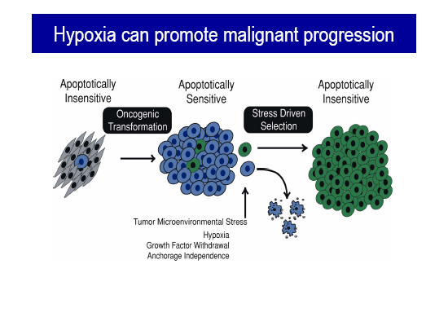

Slide 57
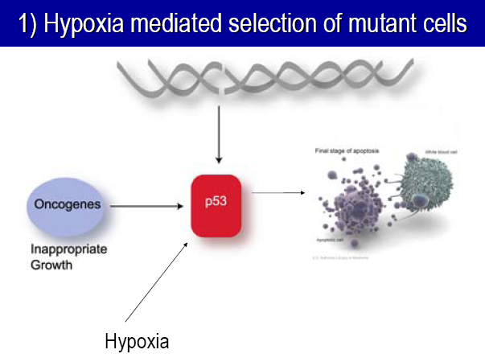

Slide 58
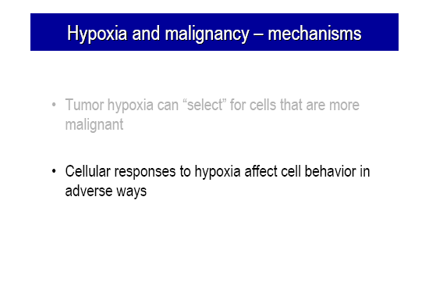

Slide 59
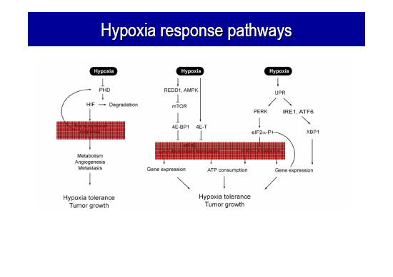

Slide 60
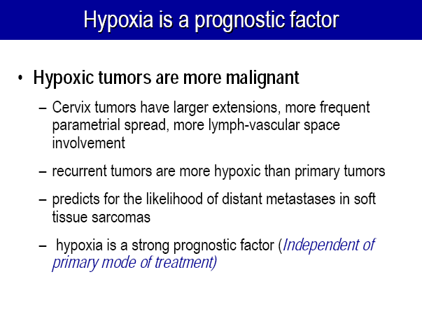

Slide 61
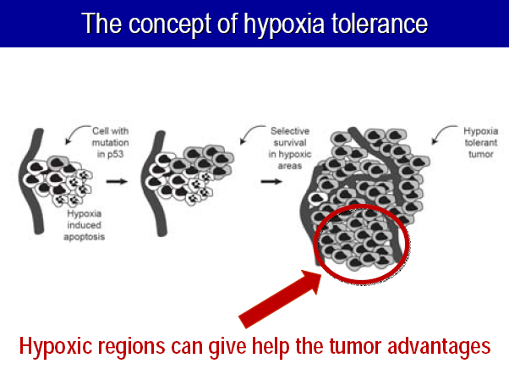

Slide 62
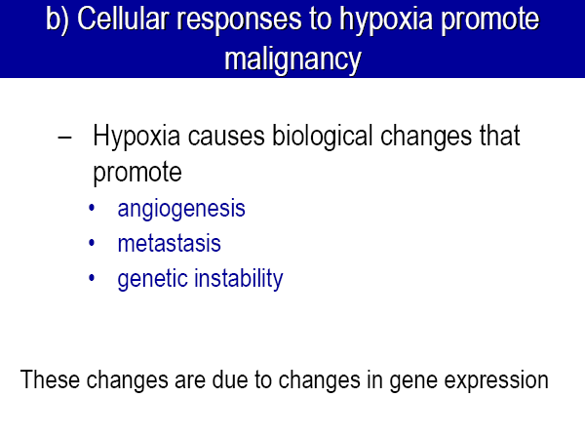

Slide 63
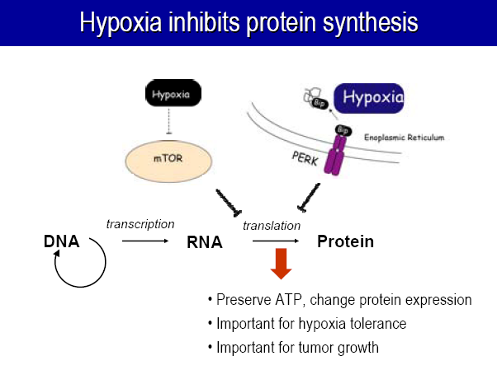

Slide 64
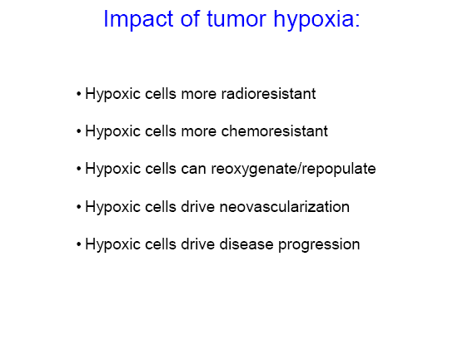

Slide 65
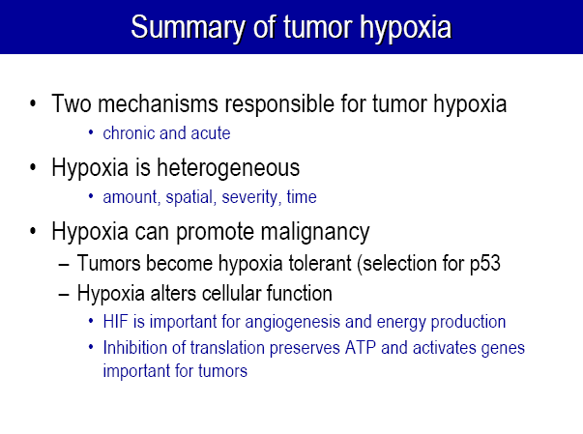

Slide 66
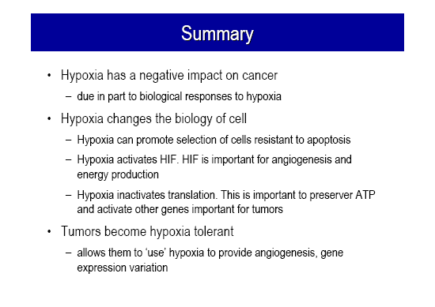

Slide 67
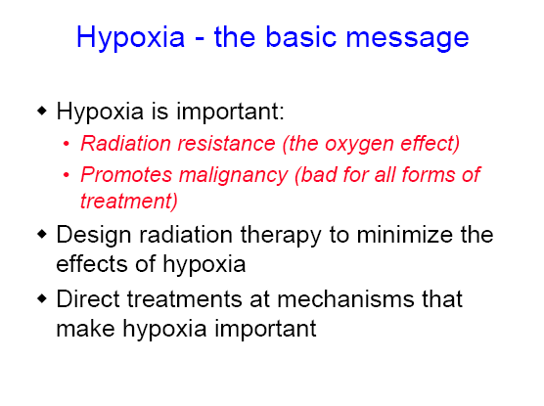

Slide 68
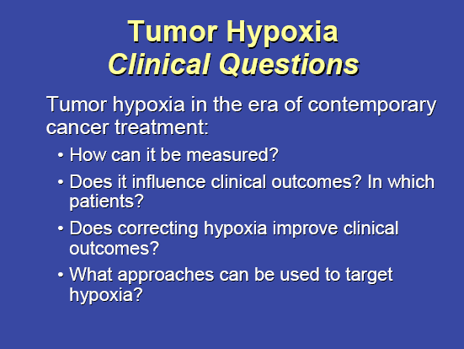

Slide 69
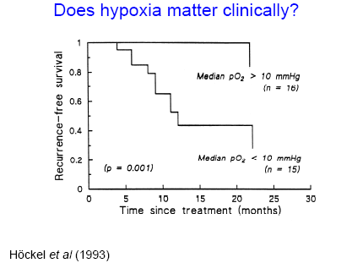

Slide 70
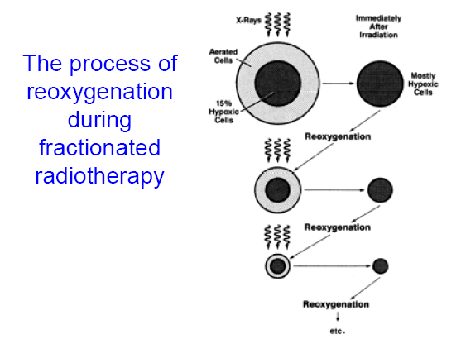

Slide 71
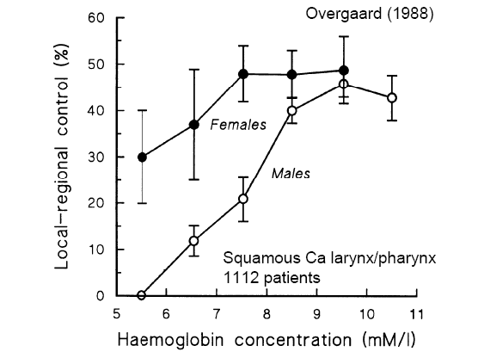

Slide 72
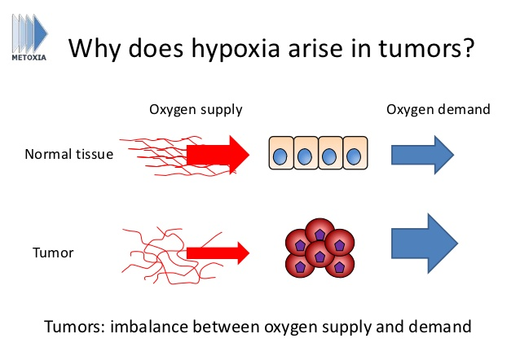

Slide 73
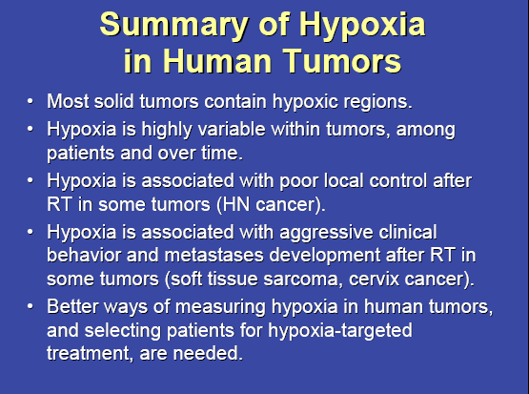

Slide 74
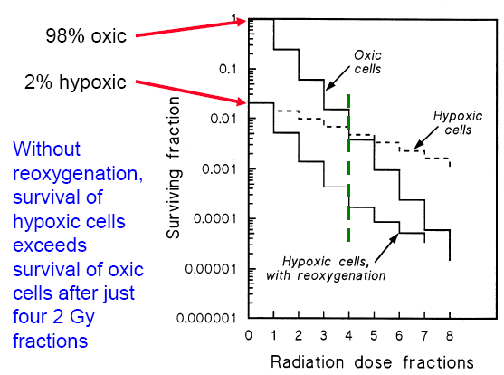

Slide 75


Slide 76


Slide 77


Slide 78


Slide 79


Slide 80


Slide 81


Slide 82


Slide 83


Slide 84


Slide 85


Slide 86


Slide 87


Slide 88


Slide 89


Slide 90


Slide 91


Slide 92


Slide 93


Slide 94


Slide 95


Slide 96


Slide 97


Slide 98


Slide 99


Slide 100


